Slide 1


5005CEM Lecture 8a: Big Data Solutions
School of Computing, Mathematics and Data Science Coventry University
5005CEM Data Science 2022/23 Semester 2

Slide 2
Recap (the problem)
Big Data: high volume/velocity/variety (+veracity, …)
Sources: transactions, interactions, observations, streaming (think Google, Apple, Facebook, Amazon, Netflix)
Storage/processing: decreasing cost and increasing power/capacity/speed of processors/memory/storage
Scalability: increasing data, increasing computational power, possible to build personalised models
Notes:
Data as personalisation: https://contentmarketinginstitute.com/2016/05/data-personalization-treasure/

Slide 3
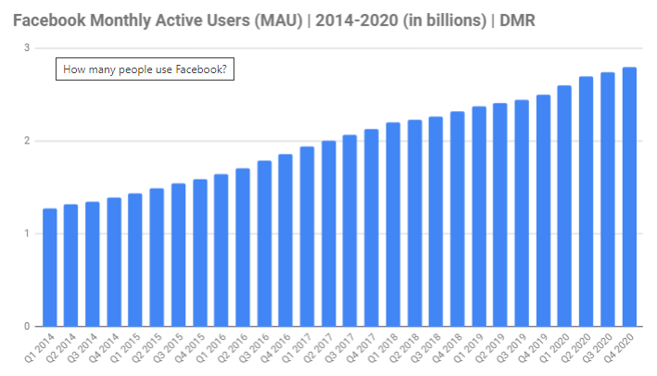
Example: Facebook
Volume: 2.8 billion active users, 250 billion photos (2021)
Velocity: 900 million photos added each day
Variety: likes, photos, messages, friends
“epic quantities, insane flow, and wide assortment”
Notes:
Reading: https://www.zdnet.com/article/volume-velocity-and-variety-understanding-the-three-vs-of-big-data/
Reading: https://expandedramblings.com/index.php/by-the-numbers-17-amazing-facebook-stats/

Slide 4
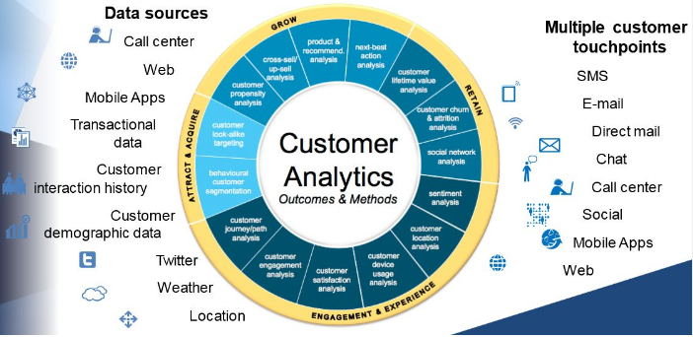
Example: Retail
Variety of unstructured data
Notes:
Reading: https://www.cazoomi.com/blog/top-9-big-data-challenges-and-how-you-can-solve-them-easily/

Slide 5

Storage: Data Silos
Idea: divide up data by content into completely separate units (data silos)
Advantage: easier to manage (each group has access to its on data sources)
Disadvantage: difficult to integrate (wasted opportunities)
Cultural, structural, technological
“Data silos are basically big data’s kryptonite.”
Notes:
Reading: https://www.piesync.com/blog/top-5-problems-with-big-data-and-how-to-solve-them/
Image from: https://geekandsundry.com/the-many-shades-of-kryptonite-their-various-forms-and-effects/

Slide 6
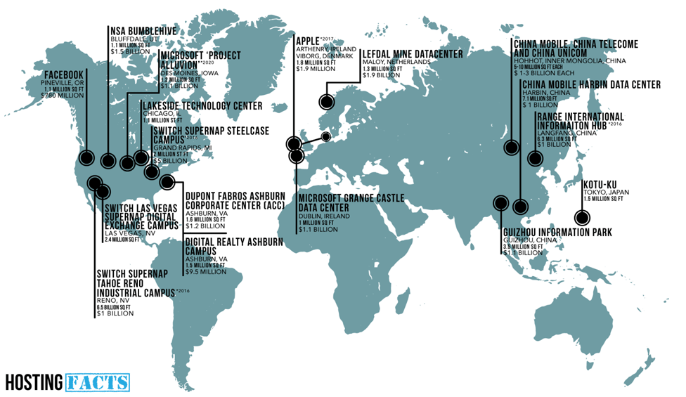
Storage: Data Centres
Notes:
Image source (from 2015): https://hostingfacts.com/where-website-live/

Slide 7

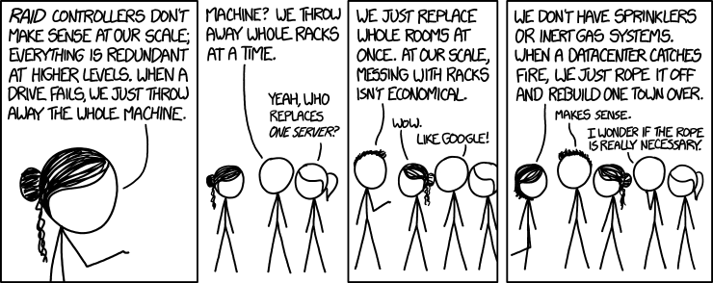
Storage: Data Centres
World’s largest data centre: China Telecom Data Centre, Hohot, China (1 million square metres)
UK’s largest data centre: KAO Data Campus, Essex (150,000 square meters)
Notes:
Reading: https://www.gigabitmagazine.com/top10/top-10-biggest-data-centres-world
Image from: https://xkcd.com/1737/

Slide 8
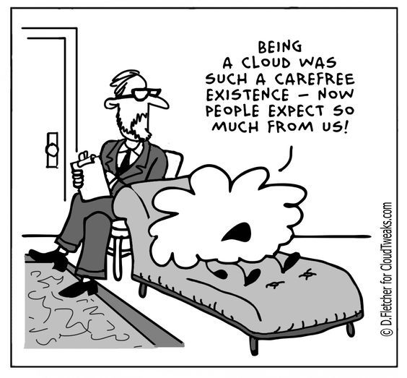
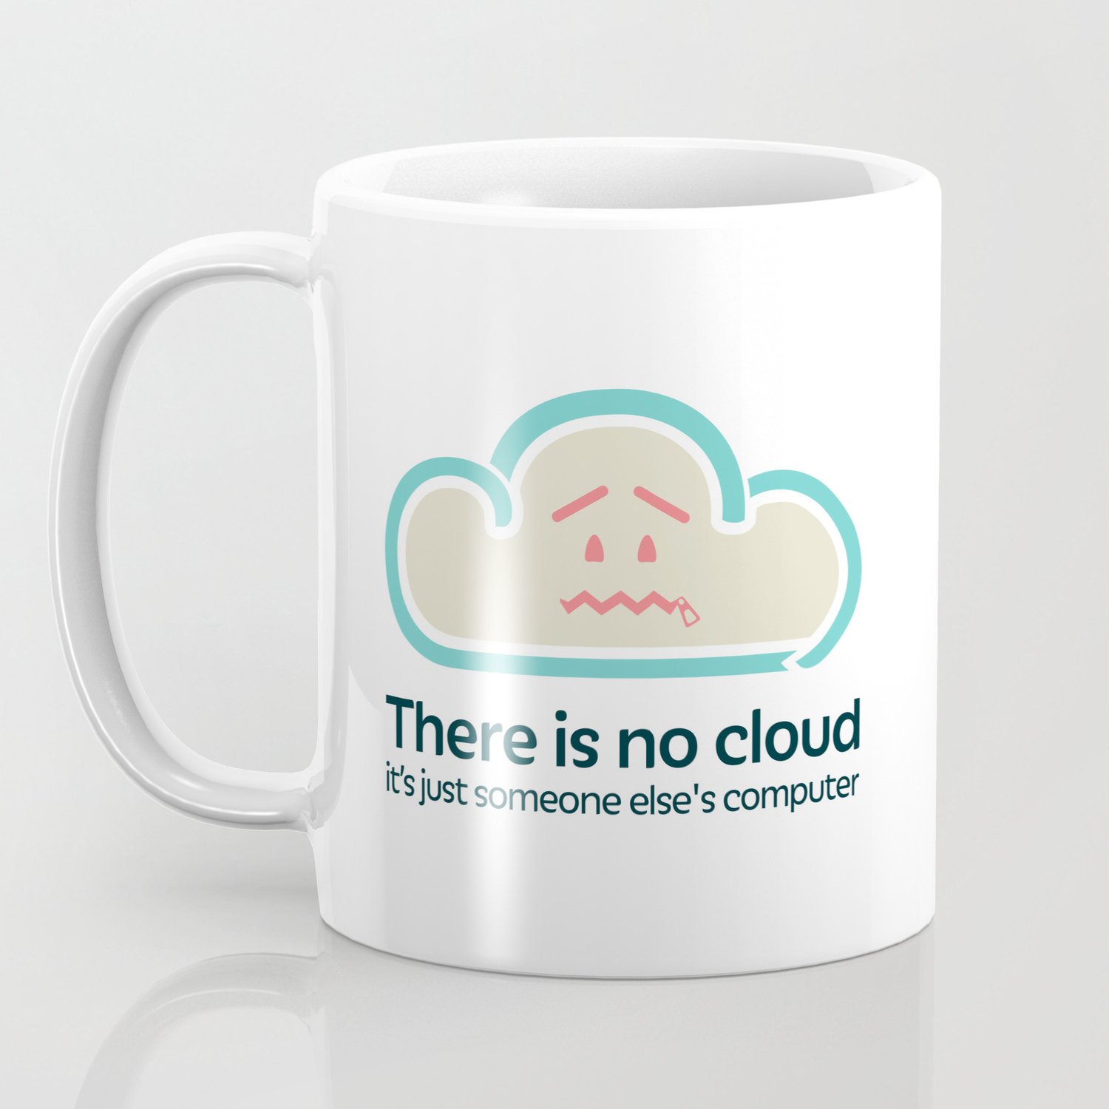
The “Cloud”
Notes:
Image from: https://whatsthebigdata.com/2017/02/24/cloud-computing-cartoons/
Image from: https://society6.com/product/there-is-no-cloud_mug

Slide 9
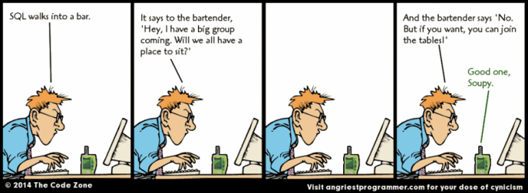
Database Solutions
Relational database model (Codd, 1969)
Structured Query Language SQL (1979)
Object-relational database model (mid-1990s)
Notes:
Comic from: https://selectivesql.wordpress.com/2016/01/13/sql-comic/

Slide 10

The World Wide Web
World-Wide-Web (Berners-Lee, 1989)
Web 1.0 (retronym, approx 1991–2004)
static html
Web 2.0 (from mid-2000s)
user-generated content (blogs, social media)
client/server (software as a service)
mass participation, e.g., Facebook
Web 3.0 …
Notes:
Image from: https://disenowebakus.net/en/web-2
Reading: https://hackernoon.com/embracing-web-3-0-the-new-internet-era-will-begin-soon-630ff6c2e7b6

Slide 11
Challenge of Big Data
Scale storage/processing systems (cheap hardware)
Vertical scaling (“scale up”)
enlarge storage on a single machine
single point of failure
Horizontal scaling (“scale out”)
distributed cluster/grid (network of servers/nodes)
requires load manager (overhead)
easy to add capacity or upgrade nodes
data sharding (splitting) and data replication

Slide 12
Distributed Databases
Issue: Relational databases do not scale well horizontally
Solution: NoSQL (“Not only SQL”) distributed databases
non-tabular data
Four main types of NoSQL databases:
Documents
Key-value (dictionary)
Wide-column (kind of two-dimensional key-value)
Graph (network)
Notes:
Reading: https://www.mongodb.com/nosql-explained

Slide 13
Consistency, Availability and Partition Tolerance
Data is replicated across the distributed database
all nodes are up and doing their work
a request comes in to any node in the network
Consistency
all clients always have the same view of the data
so every read receives the most recent write or an error
different from the term in ACID
Notes:
Reading: https://robertgreiner.com/cap-theorem-revisited/
Reading: https://bikas-katwal.medium.com/mongodb-vs-cassandra-vs-rdbms-where-do-they-stand-in-the-cap-theorem-1bae779a7a15
Not the same as ACID (atomicity, consistency, isolation, durability)

Slide 14
Consistency, Availability and Partition Tolerance
Availability
each client can always read and write
so every request receives a response (is processed)
but no guarantee response will contain the most recent write
Partition tolerance
physical partition of nodes in the network
some messages are lost or delayed between partitions
system always continues to operate despite momentary failures
System works well when no network failures (C/A/P).

Slide 15
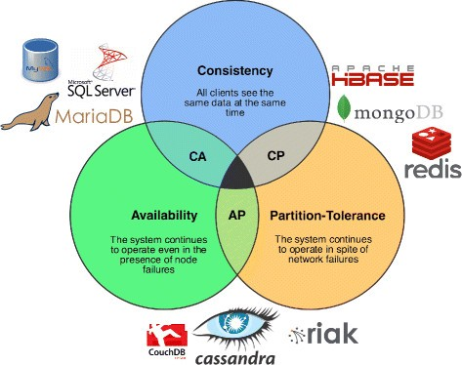
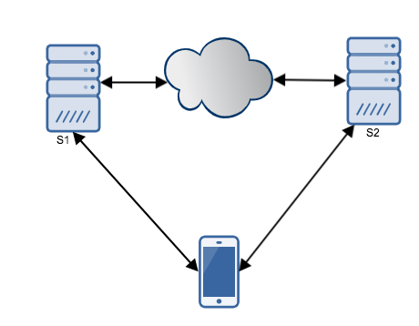
CAP Theorem (Brewer, 2000)
CAP Theorem: any networked shared-data system can have at most two of the CAP properties.
Example: two servers
network failure occurs but C/A/P
Notes:
Reading: https://medium.com/system-design-blog/cap-theorem-1455ce5fc0a0
Suppose distributed database is C/A/P but a temporary network failure occurs.
Write request to S1.
Consistent, so S1 must update S2 before confirming to client, but S1 cannot (not Available).
Available, so S1 responds to clinet without waiting for S2 update, then request comes to S2 (not Consistent).

Slide 16
Benefits of “Cloud” Computing
Speed — vast amounts of computing resources can be provisioned in minutes.
Cost — eliminates expense of buying computer hardware and software.
Scalability — easy to scale up your cloud capacity.
Accessibility — easy to access data anywhere.
Security — your data is stored in a centralised secure location.

Slide 17
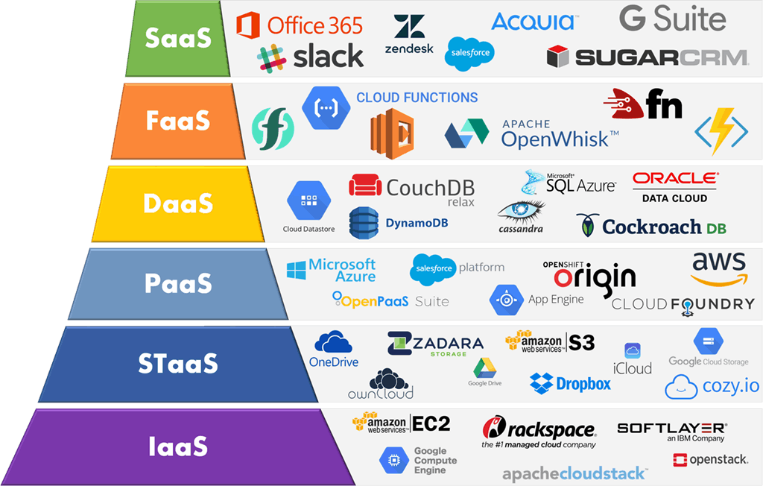
Cloud Service Models
SaaS = Software as a Service
FaaS = Function
DaaS = Data
PaaS = Platform
STaaS = Storage
IaaS = Infrastructure
Notes:
Reading: https://kinsta.com/blog/google-cloud-vs-aws/
See the Gartner Magic Quadrant for Cloud Infrastructure

Slide 18
Summary
Big Data: high volume/velocity/variety (+veracity, …)
Need to scale storage/processing systems
Require horizontal scaling of data storage
Avoid single point of failure
Distributed database (cluster of data nodes)
Data sharding and data replication
NoSQL (“Not only SQL”), unstructured data
Consistency, Availability, Partition tolerance (CAP theorem)
Cloud computing

Slide 19

Further Reading
If you are interested to find out more …
J. Leskovec, A. Rajaraman, and J. Ullman. Mining of Massive Datasets (3rd edition), Cambridge University Press, 2020. [free from http://www.mmds.org/]

Slide 20
Class Discussion Question
Consider the flight bookings system of a large airline.
Suppose the flight bookings dataset is stored in a distributed NoSQL database and that a large number of travel agents have read and write access to this distributed database.
By considering the CAP Theorem, describe what issues might arise when two travel agents make bookings in each of a “CP” or “AP” distributed system.

